Slide 1
Entrepreneurship
THE BUSINESS PLAN: CREATING AND STARTING THE VENTURE

Slide 2
Objectives
Building Business Models
  An innovative product may be a feat of engineering, but that does not automatically turn it into a commercial success. What makes the difference between success in the lab and success in the marketplace is the business model.
  How will you create and deliver value for your customers?
  How will you extract some of that value for your organization?
Analyzing New Venture Opportunities

Slide 3
Planning as Part of the Business Operation
Plans provide guidance and structure in a rapidly changing market environment.
Plans get finalized as the entrepreneur has a better sense of the market, the product or services, the management team, and the financial needs of the venture.
They help meet short-term or long-term business goals.

Slide 4
What is the Business Plan?
A written document describing all relevant internal and external elements, and strategies for starting a new venture.
It is an integration of functional plans; addresses short-term and long-term decision making for the first three years of operation.

Slide 5
Who Should Write the Plan?
The plan should be prepared by the entrepreneur in consultation with other sources.
The entrepreneur should make an objective assessment of his or her own skills before deciding to hire a consultant.

Slide 6
Scope and Value of the Business Plan, Who Reads the Plan?
Who is expected to read the plan can often affect its actual content and focus.
In preparing the plan it is important to consider the:
  Entrepreneur’s perspective.
  Marketing perspective.
  Investor's perspective.

Slide 7
Scope and Value of the Business Plan—Who Reads the Plan? (cont.)
Depth and detail in the business plan depend on:
  Size and scope of the proposed new venture.
  Size of the market.
  Competition.
  Potential growth.

Slide 8
Scope and Value of the Business Plan—Who Reads the Plan? (cont.)
The business plan is valuable because it:
  Helps determine the viability of the venture in a designated market.
  Guides the entrepreneur in organizing planning activities.
  Serves as an important tool in obtaining financing.
This process provides a self-assessment by the entrepreneur.

Slide 9
How do Potential Lenders and Investors Evaluate the Plan?
The business plan must reflect:
  The strengths of management and personnel.
  The product/service.
  Available resources.
Lenders are interested in the venture’s ability to pay back the debt.
  Focus on the four Cs of credit - Character, cash flow, collateral, and equity contribution.
Banks want an objective analysis of the business opportunity and the risks.

Slide 10
How do Potential Lenders and Investors Evaluate the Plan? (cont.)
Investors, particularly venture capitalists, have different needs:
  Place more emphasis on the entrepreneur’s character.
  Spend much time conducting background checks.
  Demand high rates of return.
  Focus on market and financial projections.

Slide 11
Presenting the Plan
The entrepreneur is expected to “sell” the business concept.
  Focus on why this is a good opportunity.
  Provide an overview of the marketing program; sales and profits.
  Address risks and how to overcome them.
Audience includes potential investors who may raise questions.
Investors describe these presentations as elevator pitches.

Slide 12
Information Needs
Before creating a business plan, the entrepreneur must undertake a feasibility study.
Information for a feasibility study should focus on marketing, finance, and production.
Feasible, well-defined goals and objectives need to be established.
  Based on this, strategy decisions can be established.

Slide 13
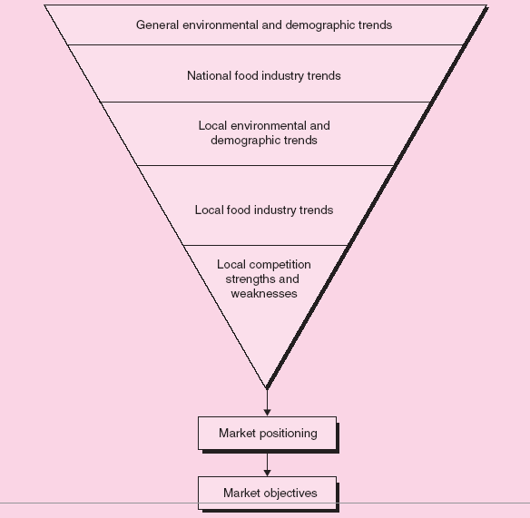
Figure 7.1 - An Upside-Down Pyramid Approach to Gathering Market Information
Includes: household income trends, population shifts, food consumption
habits and trends, travel, and employment trends…..
Where can we find this information in Pakistan?

Slide 14
Figure 7.1 - An Upside-Down Pyramid Approach to Gathering Market Information
Includes: total food sales and commercial restaurant sales by type of
restaurant…..
Where can we find this information in Pakistan?

Slide 15
Figure 7.1 - An Upside-Down Pyramid Approach to Gathering Market Information

Slide 16
Information Needs (cont.)
Operations Information Needs
  Location.
  Manufacturing operations.
  Raw materials.
  Equipment.
  Labor skills.
  Most of the information should be incorporated directly into the business plan.

Slide 17
Financial Information Needs
The entrepreneur has to prepare a budget of all possible expenditures and revenue sources, including sales and any external available funds.
The budget includes capital expenditures, direct operating expenses, and cash expenditures.
Industry benchmarks can be used in preparing the final statements in the financial plan.

Slide 18
Using the Internet as a Resource Tool
The Internet can provide information for industry analysis, competitor analysis, and measurement of market potential.
It is a valuable resource in later-stage planning and decision making; provides opportunities for marketing strategy.
An entrepreneur can access:
  Popular search engines.
  Competitors’ Web sites.
  Social networks, blogs, and discussion groups.

Slide 19
Writing the Business Plan
A business plan should be comprehensive enough to give any potential investor a complete picture and understanding of the new venture.
It should help the entrepreneur clarify his or her thinking about the business.
Business plan examples:
  https://www.smallstarter.com/know-the-basics/100-free-sample-business-plan-templates-for-african-entrepreneurs/
  https://articles.bplans.com/a-standard-business-plan-outline/#simplebplanoutline

Slide 20
Writing the Business Plan (cont.)
Introductory Page
  Name and address of the company.
  Name of the entrepreneur(s), telephone number, fax number, e-mail address, and Web site address.
  Description of the company and nature of the business.
  Statement of financing needed.
  Statement of confidentiality of report.

Slide 21
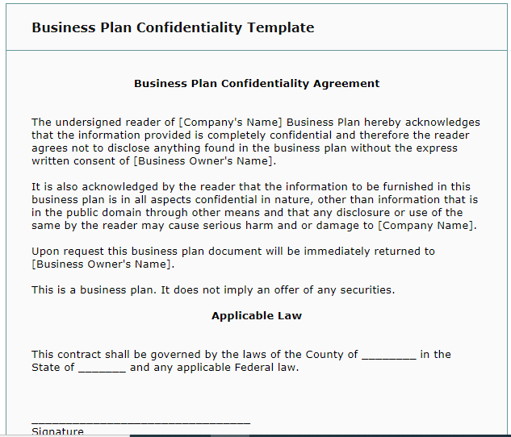
Confidentiality example

Slide 22
Writing the Business Plan (cont.)
Executive Summary
  About two to three pages in length summarizing the complete business plan.
Environmental and Industry Analysis
  The environmental analysis assesses external uncontrollable variables that may impact the business plan.
    Examples: Economy, culture, technology, legal concerns, etc.
  The industry analysis involves reviewing industry trends and competitive strategies.
    Examples: Industry demand, competition, etc.

Slide 23
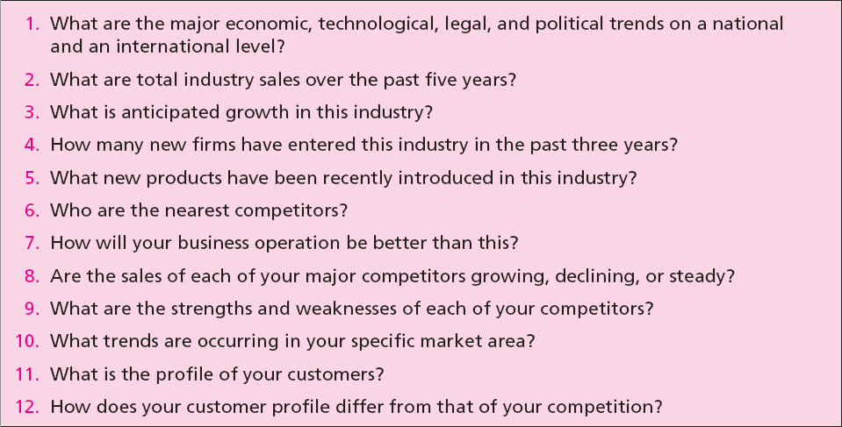
Table 7.5 - Critical Issues for
Environmental and Industry Analysis

Slide 24
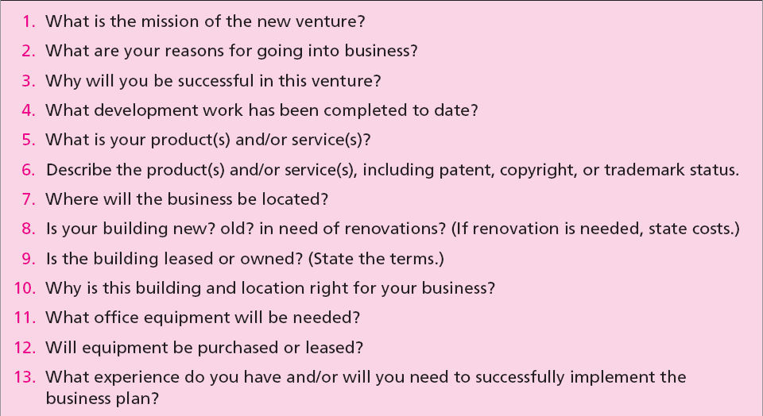
Table 7.6 - Describing the Venture

Slide 25
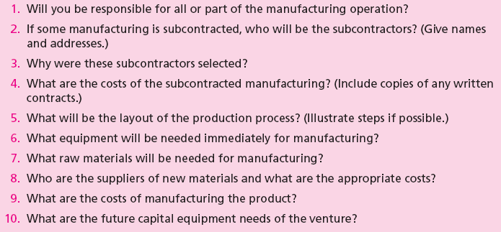
Table 7.7 - Production Plan

Slide 26
Writing the Business Plan (cont.)
Operations Plan
  All businesses (manufacturing or nonmanufacturing) should include an operations plan as part of the business plan.
  It goes beyond the manufacturing process.
  Describes the flow of goods and services from production to the customer.
  The major distinction between services and manufactured goods is services involve intangible performances.

Slide 27
Writing the Business Plan (cont.)
Marketing Plan
  It describes market conditions and strategy related to how the product/service will be distributed, priced, and promoted.
  Marketing research evidence to support any of the marketing decision strategies as well as for forecasting sales should be described in this section.
  Potential investors regard the marketing plan as critical to the success of the new venture.

Slide 28
Writing the Business Plan (cont.)
Organizational Plan
  It describes the form of ownership and lines of authority and responsibility of members of new venture.
  In case of a partnership, the terms of the partnership should be included.
  In case of a corporation, the following should be included:
    Shares of stock authorized and share options.
    Names, addresses, and resumes of directors and officers.
    Organization chart indicating the line of authority and the responsibilities of the members.

Slide 29
Writing the Business Plan (cont.)
Assessment of Risk
  Identifies potential hazards and alternative strategies to meet goals and objectives.
  The entrepreneur should indicate:
    Potential risks to the new venture.
    Impact of the risks.
    Strategy to prevent, minimize, or respond to the risk.
  Major risks could result from:
    Competitor’s reaction.
    Weaknesses in marketing/ production/ management team.
    New advances in technology.

Slide 30
Writing the Business Plan (cont.)
Financial Plan
  It contains projections of key financial data that determine economic feasibility and necessary financial investment commitment.
  It should contain:
    Summarized forecasted sales and appropriate expenses for at least the first three years.
    Cash flow figures for three years.
    Projected balance sheet.

Slide 31
Writing the Business Plan (cont.)
Appendix
  It contains any backup material that is not necessary in the text of the document.
  It may include:
    Letters from customers, distributors, or subcontractors.
    Secondary data or primary research data used to support plan decisions.
    Leases, contracts, or other types of agreements.
    Price lists from suppliers and competitors.

Slide 32
Using and Implementing the Business Plan
The business plan is designed to guide the entrepreneur through the first year of operations.
The strategy should contain control points to determine progress and to initiate contingency plans if necessary.
Without good planning employees will not understand the company’s goals.
Businesses fail due to entrepreneur’s inability to plan effectively.

Slide 33
Using and Implementing the Business Plan (cont.)
Measuring Plan Progress
  Business plan projections are made on a 12-month schedule but the entrepreneur should frequently (monthly) check on:
    Profit and loss statement.
    Cash flow projections.
    Inventory control.
    Production control.
    Quality control.
    Sales control.
    Web site control.

Slide 34
Using and Implementing the Business Plan (cont.)
Updating the Plan
  Entrepreneurs must be sensitive to changes in the company, industry, and market.
  Determine what revisions are needed if changes are likely to affect the business plan.
  This helps entrepreneurs to:
    Maintain reasonable targets and goals.
    Keep the new venture on a course to high probability of success.

Slide 35
Why Some Business Plans Fail
Goals are unreasonable.
Objectives are not measurable.
Entrepreneur has not made a total commitment to the business.
Lack of experience in the planned business.
No sense of potential threats or weaknesses to the business.
No customer need was established for the proposed product or service.

